Slide 1
Greater Manchester School Games
The case for change
Strategic positioning
Proposed structure for academic year 2019/2020

Slide 2
Greater Manchester School Games
The case for change

Slide 3
Active Lives - Children and Young People Survey
6 out 10 CYP not active enough
35.8 %
24.3 %
23.4 %
16.5 %
35.8% OF CHILDREN AND YOUNG PEOPLE (137.8k) DO LESS THAN AN AVERAGE OF 30 MINUTES A DAY vs 32.9% NATIONALLY
24.3% (96.7k) ARE FAIRLY ACTIVE BUT DON’T REACH AN AVERAGE OF 60 MIUNTES A DAY vs 23.9% NATIONALLY
23.4% (90k) DO AN AVERAGE OF 60 MINUTES OR MORE A DAY BUT DON’T DO 60 MINUTES EVERY DAY vs 25.7% NATIONALLY
16.5% (63.3k) DO 60 MINUTES OR MORE EVERY DAY vs 17.5% NATIONALLY

Slide 4
Activity levels across the localities

Slide 5
Achieving 30 Mins At School

Slide 6
Achieving 30 mins Outside of School

Slide 7
Obesity
Notes:
*

Slide 8
Headline demographic breakdown
Years 5 -8 most likely to be active every day
Boys 6% more likely to be active every day than girls
Where family affluence is high, more likely to be active every day
BAME most likely to be less active (especially girls)
Similar levels of active every day among those with/without a disability but those with a disability more likely to be less active

Slide 9
Mental wellbeing
Boys have higher average levels of mental wellbeing than girls
Higher for those who are active everyday, then active across a week, then fairly active and finally less active.
Also positive association with volunteering and mental wellbeing.
How Happy did you feel yesterday? (out of 10)

Slide 10
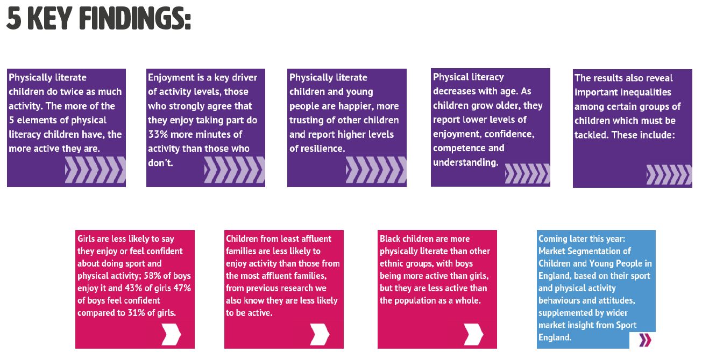
CYP Attitudes towards sport and activity

Slide 11
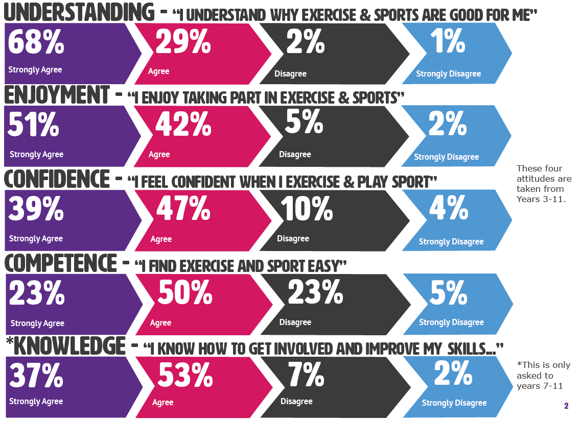
Attitudes towards sport and activity
97%
93%
76%
73%
90%
Notes:
*

Slide 12
Greater Manchester School Games
Strategic positioning

Slide 13
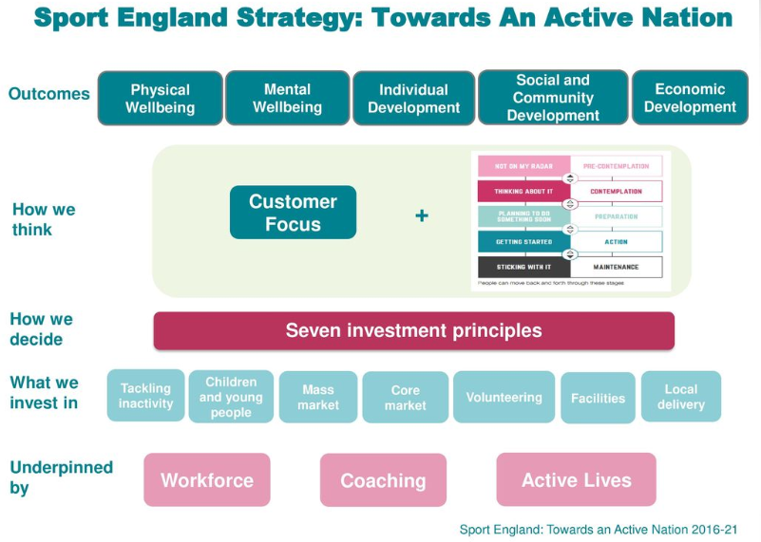
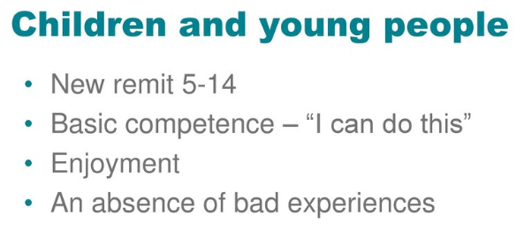
Sport England Strategy - Towards An Active Nation

Slide 14
Greater Manchester Strategy

Slide 15
GM childhood…the complexities
Taken from the GM Children & Young People Health & Wellbeing Framework 2018 -2022

Slide 16
GMCA: The Children and Young People’s Plan 2019-2022
Priorities
School readiness: The best start in life and the right support to be ready to learn
Quality education and outcomes: Increasing the quality of education and educational achievement
Special educational needs and disabilities (SEND)
Looked after children and care leavers
Ready for life: Transition to adulthood
Healthy children and young people
Safe children and young people
https://www.greatermanchester-ca.gov.uk/media/2115/gmca-children-young-peoples-plan-2019-2022.pdf

Slide 17
Greater Manchester Moving
Increasing the proportion of us who are regularly active will result in better physical and mental health and wellbeing, the strengthening of friendships, family and community relationships.
It will help our city region to flourish, with a stronger, more vibrant economy.
(Andy Burnham, Mayor of Greater Manchester, July 2017)

Slide 18
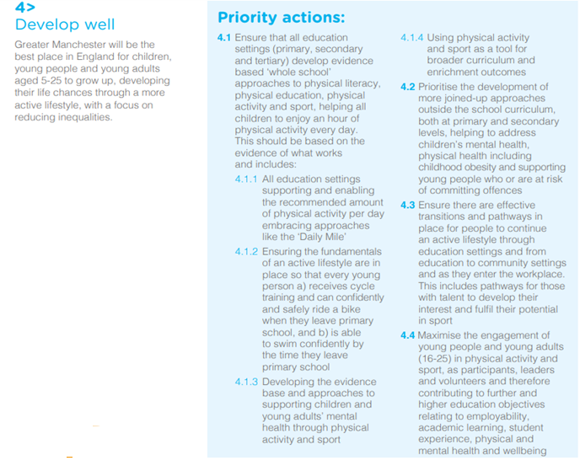
Greater Manchester Moving

Slide 19
Greater Manchester School Games
Proposed structure for academic year 2019/2020

Slide 20
National review and key recommendation

Slide 21
New mission, vision and characteristics
Mission
Keeping competitive sport at the heart of schools and providing more young people with the opportunity to compete and achieve their personal best.
Vision
By 2020 the School Games will be continuing to make a clear and meaningful difference to the lives of even more children and young people.
Characteristics
The next phase of development of the School Games will focus on ensuring it is relevant to more children and young people and their lives today and allows more of them to achieve their potential. In driving this forward the School Games will seek to:
Engender a sense of competence
Promote enjoyment
Avoid negative or bad experience

Slide 22
Relevance to Young People
To be relevant to young people and their lives, the School Games will evolve so it:
Is relevant to schools nurturing the development of character, values and life skills.
Contributes to daily physical activity.
Harnesses the power of digital technology and is vibrant, engaging and relevant to children and young people today.
Leverages the inspiration of This Girl Can and reaches more girls and young women plus reach out to other under-represented groups (including those with special education needs or disability).
Is increasingly organised, coached and officiated by children and young people.
Aids retention through primary-secondary transition.
Embraces a positive role for parents.
Builds off the excitement of (UK hosted) major events.

Slide 23
Young People reaching their potential
To allow children and young people to fulfil their potential, the School Games will evolve so it:
Is become even more inclusive.
Adds depth and aids retention within the participant pathway.
Contributes to the duty of care for young athletes and provides multi-sport opportunities.
Promotes innovation in talent assessment, transfer and development.
Embraces ‘apprentice’ team managers, coaches, and officials.
Raises the aspirations of spectators and competitors.
Promotes the very best outcomes of school sport.

Slide 24
Principles of competition

Slide 25
Themes of Different Approaches to Competition
Theme 1: Widening the competition environment to develop character and life skills
Theme 2: Adapting the scoring to develop different sport skills
Theme 3: Adding fun elements to engage new audiences
Theme 4: Widening the competition environment to develop health
Theme 5: Adapting the format to increase motivation
Theme 6: Considering age or maturity levels to support fair competition and foster social connections
Theme 7: Using technology to develop physical skills
Theme 8: Adapting the competition environment to support individual development in sport
©YouthSportTrust2019

Slide 26
Three-pronged approach
Elite events to be known as ‘School Games Excel Events’
Values events to be known as ‘School Games Values Events’
Can do events to be known as ‘School Games Bee Proud Events’

Slide 27
School Games Excel Events
Winners from across the ten boroughs of Greater Manchester.
Pathway opportunities.
Opportunity for high competent, high confidence pupils to still represent their school/stay engaged with the SG.
Continues to nurture skill development and personal best.

Slide 28
School Games Values Events
Winners selected from those who best demonstrate the SG values.
Competitive, but clear focus on enjoyment.
Engenders wider participation and experience of the L3 events.

Slide 29
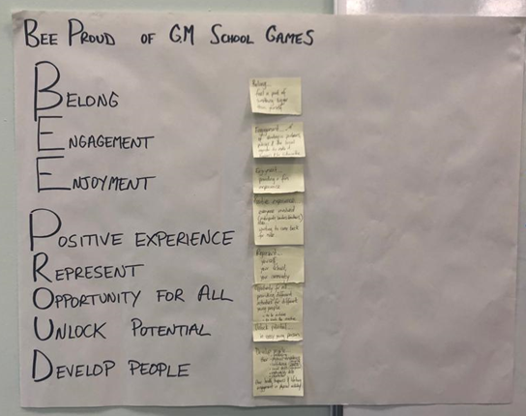
School Games Bee Proud Events
Devoted to those not currently participating in sport or physical activity.
Appropriate formats adopted to foster enjoyment, confidence and personal best regardless of ability i.e. skills based.
Ensures the SG programme becomes even more inclusive.

Slide 30
Proposed calendar of events
Primary Winter Event Date 23rd or 24th March 2020 Etihad Campus | Number of teams per borough
Sports Hall Athletics Year 5/6 | 2 x SG Excel
Boccia Year 5/6 | 2 x SEN
Dodgeball Year 5/6 | 1 x SG Excel, 1 x SG Values
Year 5/6 Tag | 1 x SG Excel, 1 x SG Values
Year 3/4 Multi Skills/Athletics | 1 x SG Bee Proud

Slide 31
Proposed calendar of events cont…
Primary Summer Event, Date 1st or 2nd July Armitage Centre | Number of teams per borough
Tri Golf Year 3/4 | 2 x SG Excel
Rounder Year 5/6 | 1 x SG Excel
NAK Year 5/6 | 2 x SEN
Table Cricket | 1 x SEN
Tag Rugby Year 3/4 | 1 x SG Bee Proud
Tri Golf Year 5/6 | 1 x SG Bee Proud
Tennis Year 3/4 | 1 x SG Bee Proud
Cricket Year 4/5* | 1 x SG Bee Proud
Quickstick Hockey Year 3/ 4 | 1 x SG Bee Proud

Slide 32
Proposed calendar of events cont…
Secondary Summer Event Date 1st or 2nd July Etihad Campus | Number of teams per borough
Year 8 - Dodgeball | 1 x Boys and 1 x Girls SG Excel
Year 7 - Quadkids | 2 x SG Excel
Ultimate Frisbee | TBC
NAK Years 7/8/9 | 1 x SEN
Boccia Years 7/8/9 | 1 x SEN
Goal Ball | 1 x SG Bee Proud

Slide 33
Proposed calendar of events cont…
Branded | Number of teams per borough
Rowing Mainstream and inclusion - w/c 9th March | 1 x SG Excel per age group
Handball U15 and U13 (Boys and Girls) - w/c 27th April | 1 x Boys and 1 x Girls SG Excel (for each age)
Grapple Tackle U13s and U15 – w/c 18th November | 1 x SG Bee Proud (for each age)
Lacrosse Year 5/6 – w/c 16th March | 1 or 2 SG Excel

